Slide 1


Kolhapur Institute of Technology, Kolhapur
Department of Computer Science & Engineering (AIML)
The Ghost Of Lab
A modular hybrid suite for LAN-based classroom management and monitoring
Team : Shubham Patil A48,
Shreeraj Gudade A73,
Anjali Wale A74,
Shreya Thorat A77
UNDER GUIDANCE OF:
Mrs. Sapna Buwa.
Date: 15th May 2026

Slide 2

Introduction & Problem Statement
The Vision
Dual-state application providing instant instructor control and broadcasting over LAN without external internet
Current Challenges
High latency in screen broadcasting
Complex setup with Maven dependencies
No silent OS-level command execution
Key Challenges
Maintaining low-latency screen broadcasting, preventing software bypass, managing persistent student data

Slide 3

Core Objectives
1
2
3
Dual-State Launcher
Real-Time Broadcasting
Global Command Console
Instant Admin/Student role assignment with modular architecture
High frame-rate screen transmission over standard LAN infrastructure
Execute remote Python scripts across all student machines simultaneously
4
5
Persistent User System
High-Fidelity GUI
Student registration and attendance tracking with local data persistence
JavaFX-powered interface with customizable themes and responsive design

Slide 4
LITERATURE REVIEW
Reference / System | Approach & Key Features | Limitations / Gaps (w.r.t. GHOST OF LAB) | Relevance to GHOST OF LAB
NetSupport School (commercial classroom management) | Provides rich classroom management: real‑time viewing and control of student screens, website and application control, tests and assessment tools, and teacher screen broadcast across platforms.systech+1 | Heavy, feature‑rich suite; not focused on low‑footprint, invisible agents on each PC, and may be costly or overkill for a single‑lab deployment.systech+1 | Shows that real‑time screen monitoring and control are established needs; GHOST OF LAB adopts a narrower, lightweight, lab‑specific subset (screen streaming, blocking, attendance) with custom control logic.
LANSchool / classroom monitoring tools | LANSchool lets teachers see all student computers, blank or lock screens, limit browsing, and show teacher/student screens; typical classroom monitoring workflow.education.umdyoutube | Focus on visible monitoring UI; less emphasis on stealthy, hard‑to‑close agents or custom integration with Python‑based system controls and AI assistants.education.umdyoutube | Motivates core requirements: see screens, remove distractions, lock inputs; GHOST OF LAB re‑implements these ideas using Java/JavaFX, hosts‑file blocking, and Python executors tuned for a single institute.
Classroom monitoring solutions overview | Surveys of classroom monitoring solutions highlight real‑time screen viewing, website blocking, locking screens, and device management as common capabilities to keep students on task.education.umd+1 | Many tools are generic, multi‑platform SaaS products with broad scope; they rarely focus on tight integration with local SQLite, UDP discovery, and low‑level OS control on each workstation.managedmethods | Justifies the design choices of GHOST OF LAB: a focused, LAN‑only tool that integrates networking (UDP/TCP), local DB, and OS‑level control tailored to a specific lab context.

Slide 5


Technologies Stack
Core Technologies
Infrastructure
Java 17+: Core logic and socket programming
Python 3.x: System-level automation
JavaFX: Rich GUI framework
TCP/IP Sockets: Data transmission
UDP: Network discovery
SQLite: Lightweight database
CSS: Custom theming

Slide 6
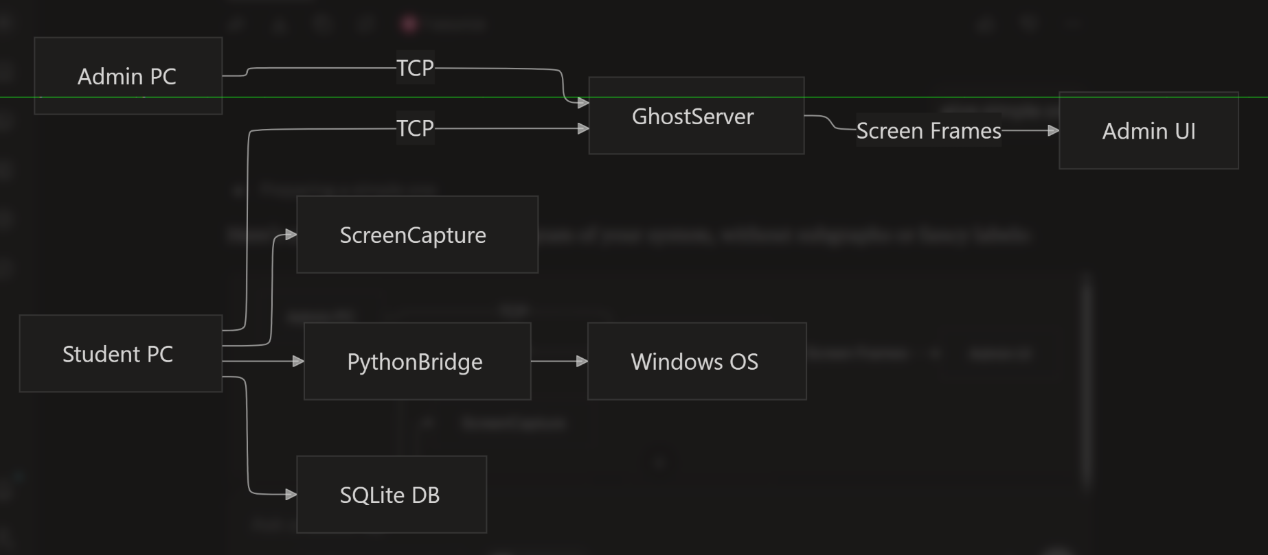
System Architecture
(UDP)

Slide 7
Key Features
Modular Engine
Admin Dashboard
Global Console
Decoupled networking and UI components enabling easy scaling and maintenance
Live thumbnail grid displaying all connected student screens in real-time
Broadcast commands to all machines or target specific PCs with precision
LAN Social Hub
File Distribution
AI INTEGRATION
Secure peer-to-peer and group chat functionality for classroom collaboration
Instant file pushing from Admin PC directly to student desktops
AI is integrated and students can use AI but with system prompt that admin can modify

Slide 8





Implementation Details
Java-Python Bridge
Java handles UI and network stability whilst Python action.py scripts execute "ghost" tasks like file creation and system monitoring
Broadcasting Logic
java.awt.Robot captures screens, compresses into byte arrays for rapid LAN transmission
UI/UX Implementation
Smooth transitions and custom toggle buttons in JavaFX with responsive design principles
UserData Persistence
Registration module stores student details locally, enabling persistent login across different lab sessions

Slide 9
Limitations & Challenges
Network Dependency
OS Constraints
Hardware Requirements
Operates exclusively on Local Area Network; performance degrades on highly congested Wi-Fi environments
Python "ghost" commands may require administrative privileges on student machines for full functionality
Real-time broadcasting and thumbnail generation demand moderate CPU usage on Admin PC and Student PC.

Slide 10

Evaluation Methodology
1
Performance Testing
Benchmark screen broadcast latency across 20+ simultaneous student nodes
2
Reliability Checks
Verify command console success rate under high network load conditions
3
UX Survey
Collect feedback on dynamic themes system and Social Hub interface usability
4
Security Audit
Ensure persistent login system correctly prevents unauthorized Admin access

Slide 11
Feature Comparison
Feature
Existing Systems
Ghost Of Lab
Deployment
Complex installers required
Portable, modular Java files
Customization
Static, hard-to-change UIs
Dynamic JavaFX themes
Control
Standard remote desktop
Python-powered "Ghost" commands
Offline Usage
Often needs cloud/internet
100% offline LAN operation

Slide 12

Conclusion
"The Ghost Of Lab" successfully integrates Java's stability with Python's flexibility, delivering a robust classroom management solution.
Modular Design
High-Impact Features
Educational Value
Scalable architecture enables future enhancements
Thumbnail dashboard and live stream viewer
Comprehensive solution for modern teaching environments

